Slide 1
Your Best Friend’s Electronic Travelling Companion
Kennel Buddy
SMU Coding Bootcamp – Project 3
Ann Newman

Slide 2
Problem Description
Fact: According to the US Transportation Department a little over a half million animals were transported via airplane cargo in 2018
Fact: The US government requires that animals cannot be exposed to temperatures less than 45 deg F
Fact: The temperature on the tarmac can get over 110 deg F while animals are waiting to be loaded
Problem
Airlines and pet owners currently have no way to monitor the temperature in their pet’s carrier/kennel

Slide 3
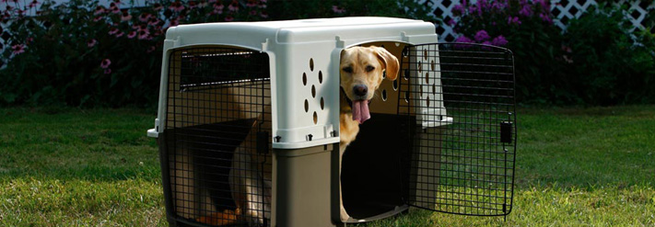


Product Solution
Introducing….
Kennel Buddy
Your best friend’s electronic travelling companion
Monitors the temperature inside your pet’s kennel
Provides realtime updates to the owner and airline

Slide 4






Overall Design
Server
KB1001
Airline Admin
Cargo Loader
KB1002
Pet Owner
.
.
.
Database

Slide 5
Development Process
Develop a realtime application on a Raspberry Pi microprocessor
A conversation with my husband → idea for a temp monitor device for live animal airline cargo transportation
Created the initial product design (see previous slide)
Used the MERN project as a code baseline
Defined the database models and API interfaces
Developed an emulated version of the temp monitor to test and integrate with the database APIs
Brought up the RPi system and wrote temp monitor Python code
Developed and tested each client page one-by-one
Dry-run on SMU_Guest network (to manually handle landing page)
Final integration and testing

Slide 6
Project Requirements
Use ReactJS and use Node and Express Web Server
Be backed by a MongoDB Database with a Mongoose ORM
Use both GET and POST routes for retrieving and adding new data
Deployed using Heroku (with Data)
Have authentication of users in some way
Polished frontend/UI
MVC Paradigm folder structure
Good quality coding standards (indentation, scoping, naming)
No exposed sensitive API key information on the server
Utilize at least two new libraries, packages, or technologies
Raspberry PI microprocessor and development system
DHT11 temperature sensor and Adafruit DHT library
Temperature monitor software is written in Python
Linked to the domain name www.kennelbuddy.com

Slide 7
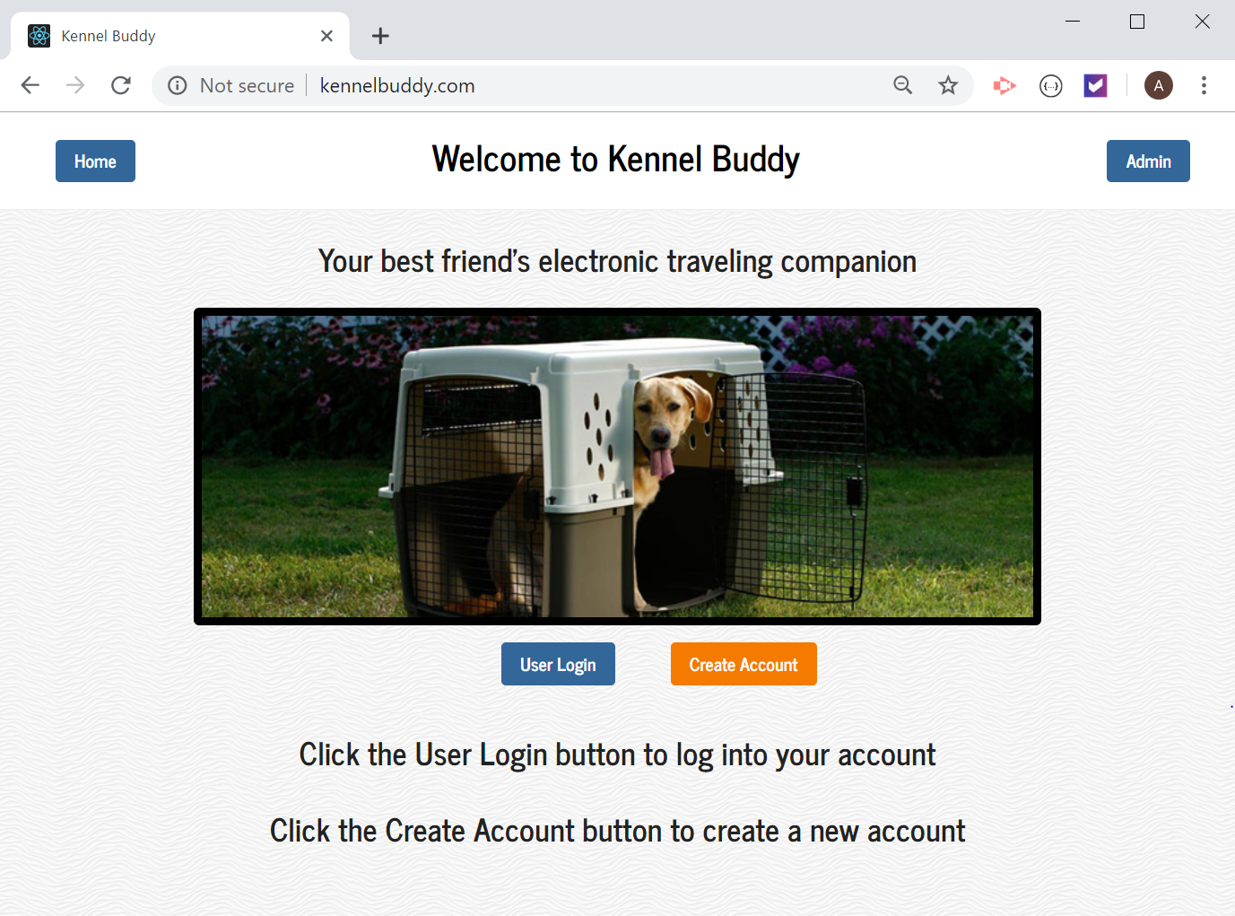
Demo Time!

Slide 8
Problems & Fixes
Problem: Could not get a temperature reading from DHT11 sensor.
Issue: The breadboard was split into 2 unconnected segments, thus the DHT11 was not getting any power
Fix: Switched to a another continuous panel breadboard
Problem: Hit max limit for number of routes
Issue: Using too many routes with both user APIs and device APIs
Fix: Redesigned the API routes to combine functions
Problem: Update user and admin clients with realtime temp data
Issue: Tried to implement “push” notifications to the user and admin clients using socket.io. Got an example to work, but could not implement in the project
Fix: Implemented timers in the react modules to update the screens

Slide 9
Product Upgrades & Future Development
Implement the temperature monitor over a cellular network not WiFi
Storage of temperature information for later analysis
Implement a data “push” technique to notify the client of new information
Implement text or email notification of over or under temperature conditions
Live video stream of the pet

Slide 10
www.kennelbuddy.com
Questions?

